Slide 1
Where should my Coffee Shop open up?

Slide 2




Why should we care?
Canadians love their coffee
Chance for economic opportunity or expansion
Bring the community closer together one cup at a time

Slide 3
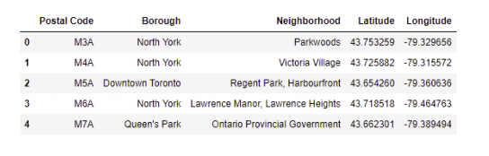
How can we accomplish this?
Foursquare data
Location information

Slide 4
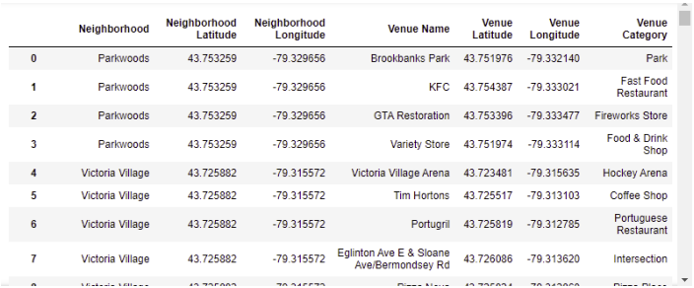
Finding all of the nearby venues is crucial
Once we access the FourSquare database, every venue in the city of Toronto will be at our fingertips

Slide 5
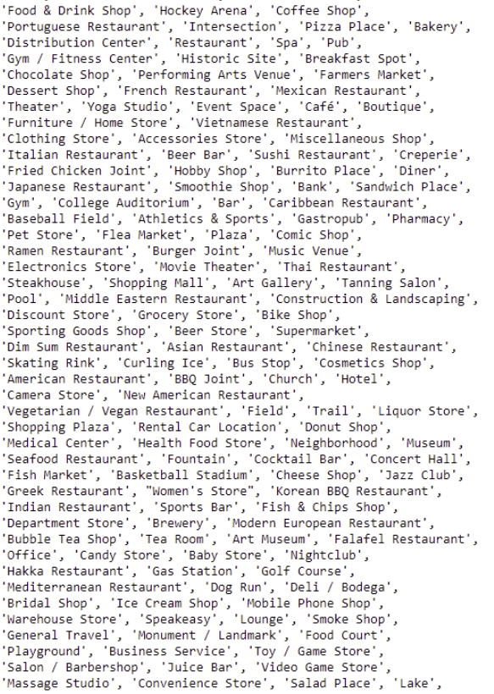
What determines a good neighborhood from a bad one?
We have all sorts of venues, what would you consider to be useful venue to be near our coffee shop?
What venues would you consider to be detrimental to have near our coffee shop?

Slide 6
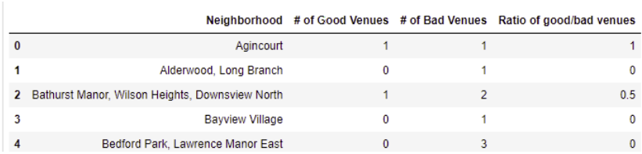
Well… what neighborhoods are near good venues?
z

Slide 7
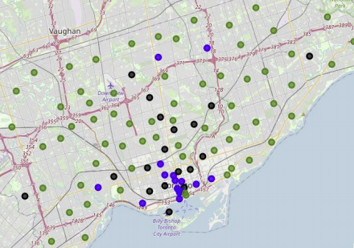
Time to group up!
Using K-Clustering, we are able to group our neighborhoods up by the number of good and bad venues that are nearby

Slide 8
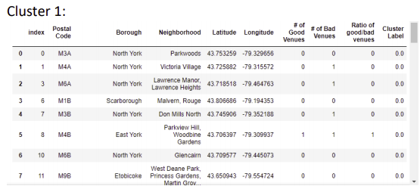
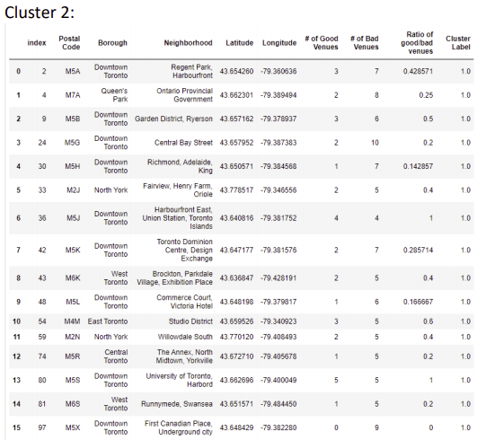
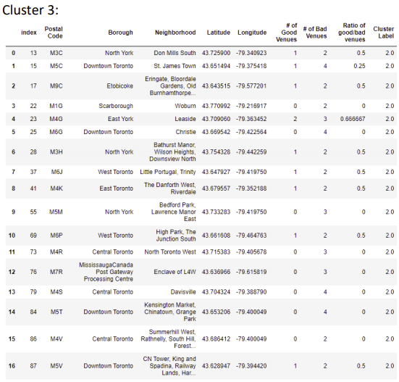
Which looks best to you?

Slide 9
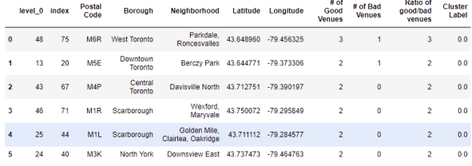
The Best of the Best
- After determining our best cluster, these are our best 6 neighborhoods-

Slide 10
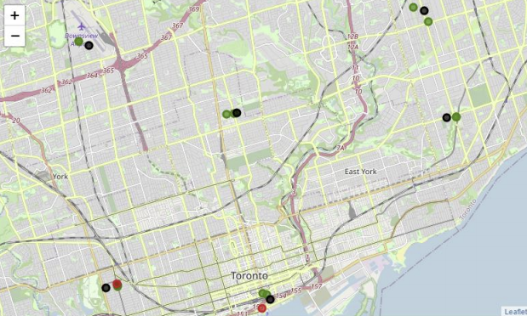
Our top neighborhoods

Slide 11
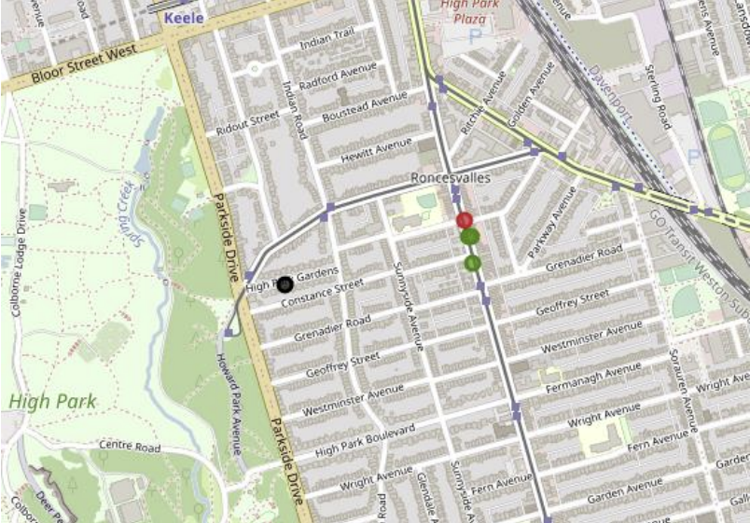
Parkdale, Roncesvalles
Local Venues:
2 Breakfast Places
1 Book Store
1 Coffee Shop

Slide 12
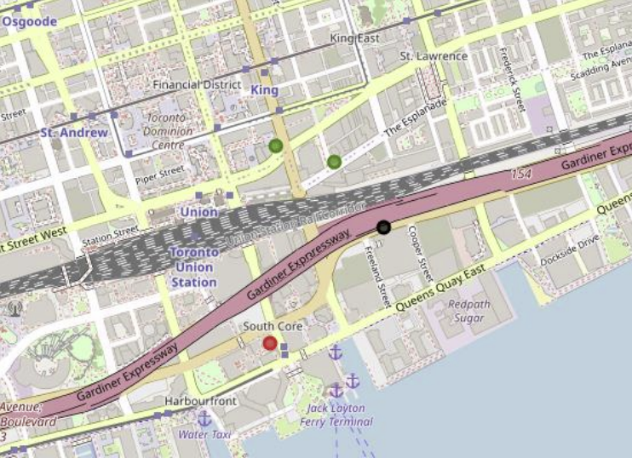
Berczy Park
Local Venues:
Museum
Breakfast Spot
Coffee Shop

Slide 13
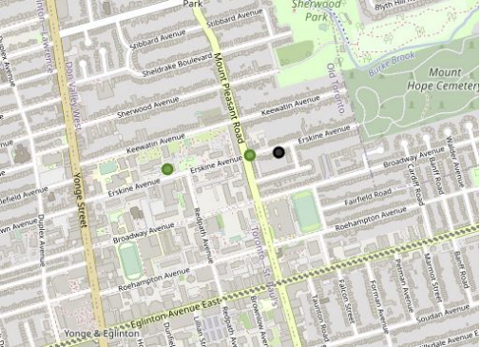
Davisville North
Local Venues:
Construction & Landscaping Business
Breakfast Spot

Slide 14
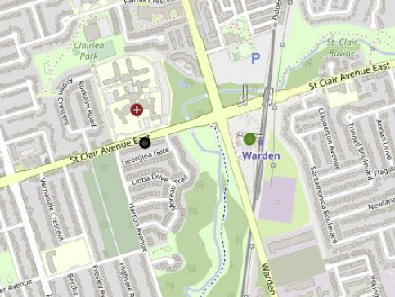
Golden Mile, Clairlea, Oakridge
Local Venues:
Metro Station
Bus Station

Slide 15
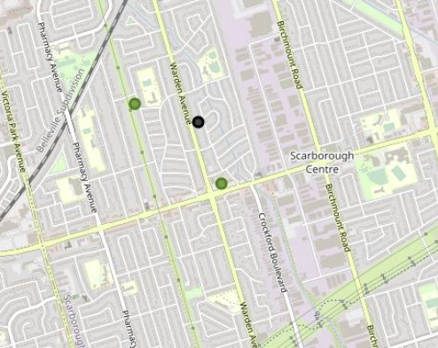
Wexford, Maryvale
Local Venues:
Shopping Mall
Auto Garage

Slide 16
Conclusion
We are able to see some of the best neighborhoods to open a coffee shop in all of Toronto based on location
There’s room for improvement for a deeper analysis. For example, we could use income data as a basis for more attributes for our machine learning algorithm
Perhaps crowdsourcing coffee interest would provide some insight into what areas desire a new coffee shop

